Slide 1
Web API Design
Jeremy Likness | Principal Architect
Christopher Harrison | Content Developer

Slide 2

Meet Jeremy Likness | ‏@jeremylikness
Principal Architect at iVision
Focused on Microsoft stack Enterprise Applications
http://csharperimage.jeremylikness.com/
Former Certified Fitness Trainer and Specialist in Performance Nutrition
Over 20 Years of Professional Experience
4-time Author incl. Programming the Windows Runtime by Example
Prolific speaker at conferences including DevLink, CodeStock, and the Microsoft Worldwide Partner Conference
5 Year Microsoft Most Valuable Professional (MVP)
9-Ball player

Slide 3

Meet Christopher Harrison | ‏@geektrainer
Content Developer, Microsoft
Focused on web and Office 365 development
Microsoft Certified Trainer
Regular presenter at conferences
Long time geek
Still misses his Commodore 64
Periodic blogger at http://blog.geektrainer.com
Marathoner, husband, father of one four legged child

Slide 4
Course Topics
Web API Design
01 | Introduction to Web API | 04 | Validation and Error Handling
02 | Basic Web API Design | 05 | Security
03 | Configuration | 06 | Advanced Web API Design

Slide 5
Setting Expectations
Target Audience
Web Application Developer
Interested in building public-facing RESTful APIs
Would like to expand knowledge of Web API design
Suggested Prerequisites/Supporting Material
Visual Studio 2013+

Slide 6
Join the MVA Community!
Microsoft Virtual Academy
Free online learning tailored for IT Pros and Developers
Over 2.6M registered users
Up-to-date, relevant training on variety of Microsoft products
“Earn while you learn!”
Get 50 MVA Points for this event!
Visit http://aka.ms/MVA-Voucher
Enter this code: WebAPIDesign (expires 4 Mar 15)

Slide 7
01 | Introduction to Web API
Jeremy Likness | Principal Architect
Christopher Harrison | Content Developer

Slide 8
Module Overview
ASP.NET Web API
Web API Design
REST
HATEOAS
Scaffolding

Slide 9
ASP.NET Web API
Overview

Slide 10
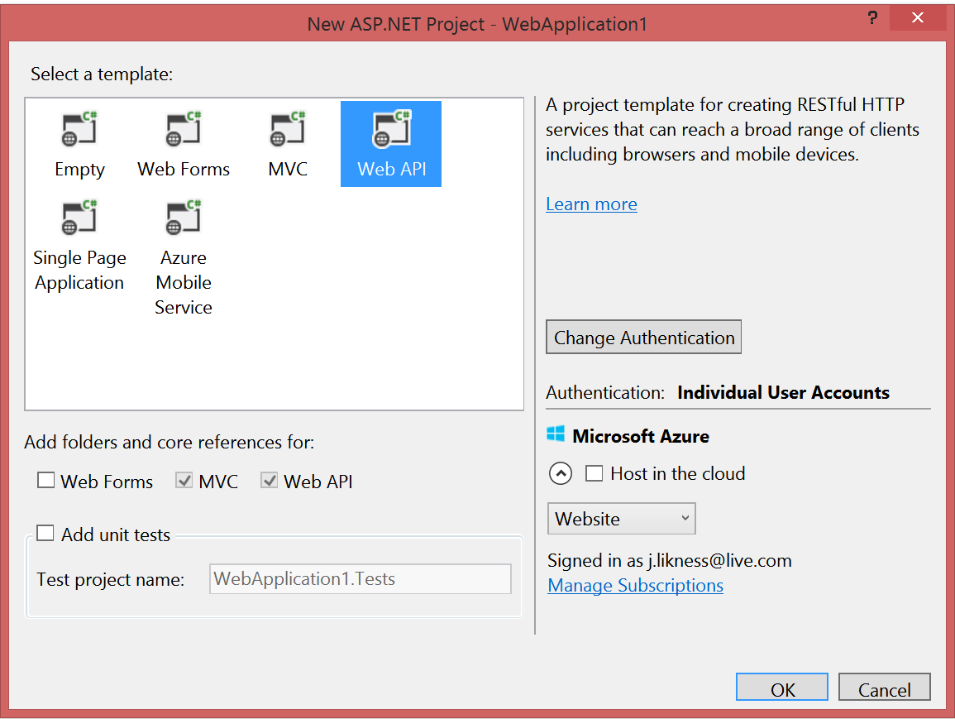
ASP.NET Web API
Option for web applications
Makes it easy to build HTTP-based services
Ideal for RESTful APIs

Slide 11
Web API Design
What this course covers

Slide 12
But what is Web API design?
An intentional approach to building APIs
A “must have” if your APIs will be consumed by third-party services
Attention to details:
How consumable is the API (signature, content negotiation)?
Does it comply with standards (response codes, etc.)?
Is it secure?
How do you handle multiple versions?
Is it truly RESTful?

Slide 13
REST
Introduction and overview of Representational State Transfer

Slide 14
Representational State Transfer (REST)
Client-server
Stateless
Resource-based (vs. remote procedure call)
HTTP methods (GET, POST, PUT, DELETE)
Indempotency and side effects
It’s a style, not a standard
Don’t hate on HATEOAS

Slide 15
HATEOAS
Hypermedia as the Engine of Application State

Slide 16
Hypermedia as the Engine of Application State (HATEOAS)
Hypermedia is the key
It all starts at a URL
Resources are returned
Media types and locations are included
References based on state

Slide 17
REST and HATEOAS in Action
Notes:
http://odata.org examples See RestDEMO.txt

Slide 18
Scaffolding
Generation of Web API projects out of the box with Visual Studio
Notes:
Show MVC with Web API, Web API, and Empty with Web API

Slide 19
Scaffolding
Notes:
Show MVC w/ Web API vs. Web API, also show Web API with individual accounts to demonstrate the token infrastructure

